Slide 1




STAC WARS
// MISSION BRIEFING
01
SOLAR RADIATION ANALYSIS
Voyage-123 decoded: read the sun, power the Rebellion
> learn the sun, power the base_

Slide 2
TRANSMISSION RECEIVED
// INCOMING SIGNAL 001
02
VOYAGE-123 // LOG
The Rebellion base runs on sunlight. To prevent blackouts, it must predict solar activity.
32,686 readings
118 days, every 5 minutes
The probe Voyage-123 logged the sun on a remote world. This is what it saw.
1 Sep to 31 Dec 2016
Radiation · temperature · pressure
Humidity · wind · sunrise · sunset

Slide 3
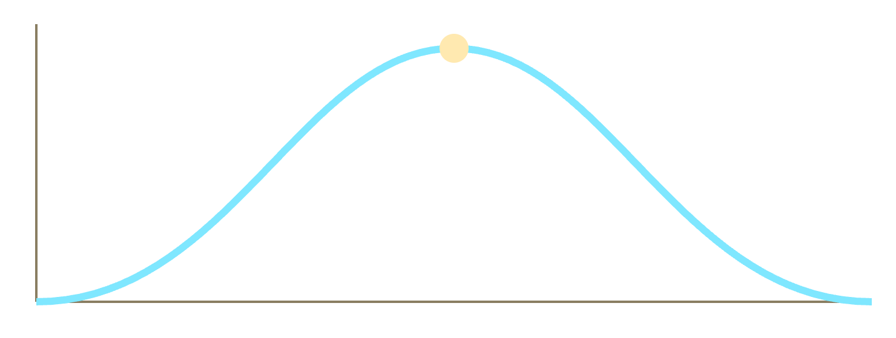
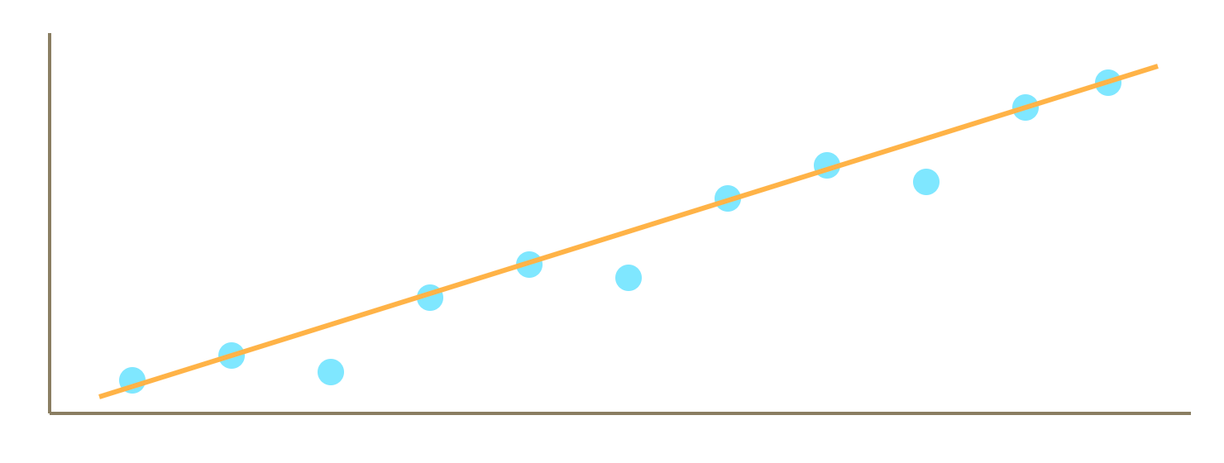
DATA VISUALIZATION
// PART A // NAVIGATION COMPUTER
03
Radiation over a day: one hump, peak at noon
Radiation vs temperature: rises together

Slide 4
DRAWING INFERENCES
// PART B // TARGETING COMPUTER
04
PEAK TIME
STRONGEST LINK
ANOMALY
12:00
r = +0.74
1601
Hour 12 averages 727.5 W/m². Near zero from 19:00 to 05:59.
Temperature. Humid midday reads 418 W/m², dry midday 856.
W/m² spike on 4 Sep, likely cloud-edge glare. 4,311 humidity readings exceed 100%.

Slide 5

SOLAR DAY ANALYSIS
// PART C // DAILY DASHBOARD
05
PEAK DAY // 2016-09-04
raw log + Pandas / NumPy
Peak 1601.26 W/m² at 12:15
df["Datetime"] = pd.to_datetime(
Temp 61 · Humidity 93% · Wind 9.0
df["Data"] + " " + df["Time"])
daily = df.groupby("Date")
Sunrise 06:08 · Sunset 18:35
["Radiation"].agg(["max","mean"])
Peak: 6 h 7 min after sunrise
Top avg days: Sep 19, 2, 22, 25, 28

Slide 6
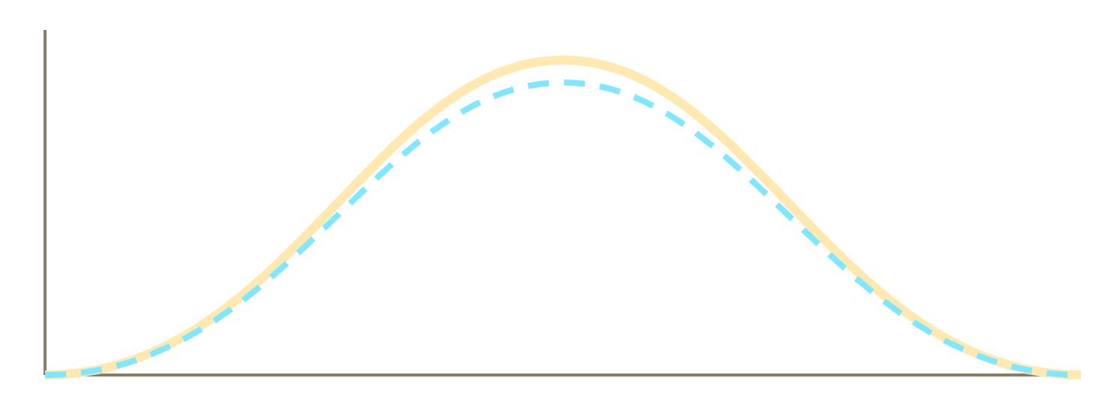
MACHINE LEARNING PREDICTION
// BONUS // PREDICTIVE RADAR
06
RMSE
R²
76.0
0.94
W/m²
random split
Random Forest. Harder chronological test: RMSE 132, R² 0.75.
Forecast (dashed) tracks the real curve
Top features: temperature (0.57), minutes since sunrise (0.16), minute of day (0.15).

